Slide 1

Welcome To….
Chapter 02:
Data Presentation (part 1)

Slide 2
Learning outcomes
Know the appropriate tool for data presentation
Exploring fact from data

Slide 3
Type of Data Presentation
1. Tabular Presentation of Data.
2. Graphical Presentation of Data.
3. Textual Presentation of Data.
Qualitative Variable
Quantitative Variable
Frequency Distribution
Bar chart
Pie Chart
Histogram
Frequency Polygon
Ogive curve
Line graph
Boxplot
Scatter Diagram
Use Words, statements or paragraphs with numbers to present data.

Slide 4
Contents
Definition of Frequency Distribution with Examples
Construction of Frequency Distribution for quantitative data
Graphical presentation of quantitative data

Slide 5
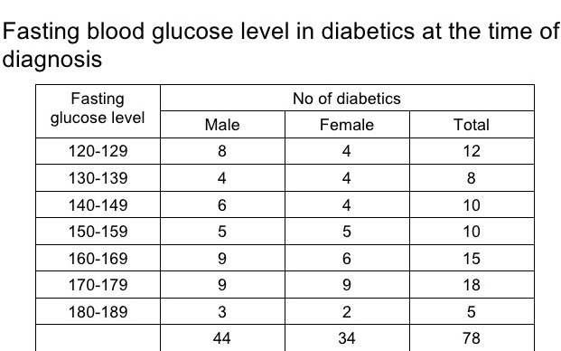
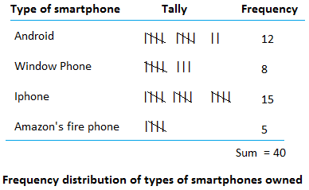
Frequency distribution with Examples
Types of Frequency Distribution:
Frequency distribution for Quantitative data
Frequency distribution for Qualitative data

Slide 6
Construction of frequency distribution for quantitative data

Slide 7
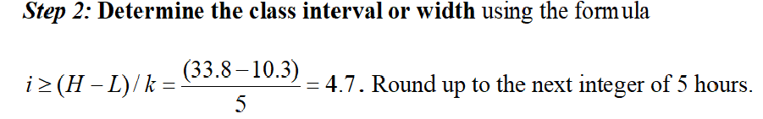
Construction of frequency distribution for quantitative data

Slide 8
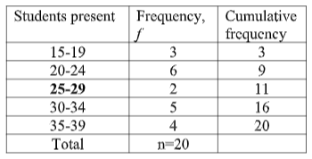
Construction of frequency distribution for quantitative data
This table is just for understanding, not necessary for this math
Upper limit
Lower limit
Example: Inclusive frequency table
Exclusive frequency table
Class interval=
Upper limit-Lower limit=
15-10=5
Class interval=
Upper limit-Lower limit+1=
19-15+1=5

Slide 9
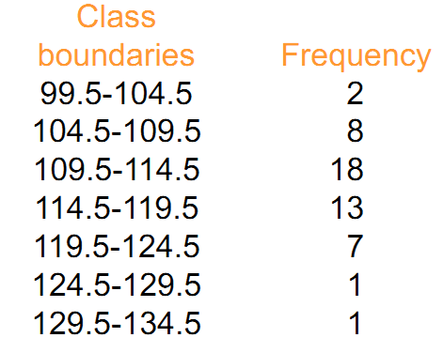
Graphical presentation of frequency distribution for quantitative data
Three types of graphical presentation for quantitative data are:
1.Histogram
2.Frequency Polygon
3. Ogive Curve/ Cumulative Frequency Curve
Draw the following graphs for this temperature data.
Histogram
Frequency Polygon
Ogive Curve/ Cumulative Frequency Curve

Slide 10
Graphical presentation of frequency distribution for quantitative data
From the calculation of the following table we will learn how to draw all the 3 mentioned graphs.
Col-1
Col-2
Col-3
Col-4
Col-5
Col-6
1. Histogram:
Col-1& 2.
2. Frequency polygon:
Col-1, 2 & 5.
2. Ogive curve:
Col-1(upper limits)& col-6.
Lower limits
upper limits

Slide 11
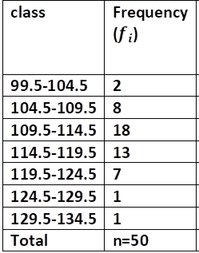
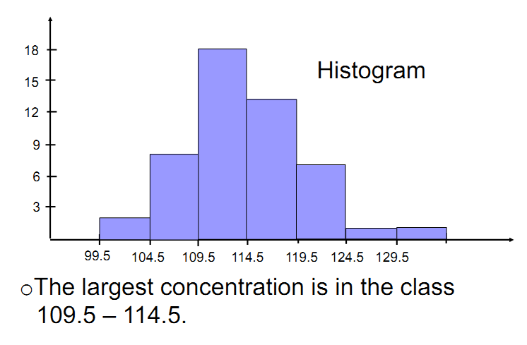
Graphical presentation of frequency distribution for quantitative data

Slide 12
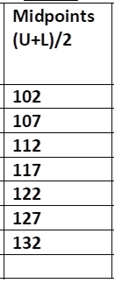
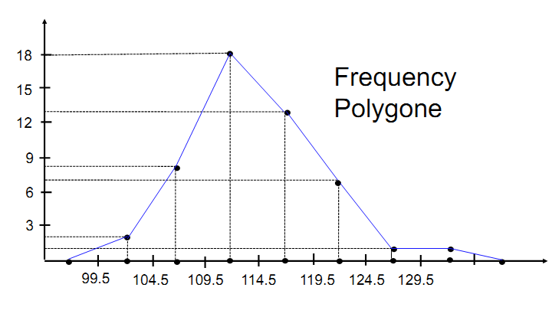
Graphical presentation of frequency distribution for quantitative data

Slide 13
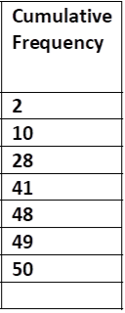
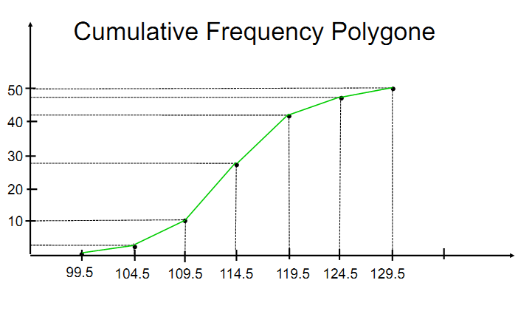
Graphical presentation of frequency distribution for quantitative data

Slide 14
Exercise to solve
The number of walking shoes sold in 20 different shops are given below:
45, 70, 70, 55, 75, 73, 70, 65, 68, 60, 74, 83, 80, 58, 68, 85, 90, 64, 75, 82
Construct a frequency distribution table using appropriate class interval.
Draw Histogram, frequency polygon and ogive curve.
How many shops were able to sold more than 70 shoes?

Slide 15



